Slide 1
2023 College GO!

Slide 2
College Application Week Goals
To encourage and assist all students to apply to college, especially those who are low-income and / or first-generation
To provide dedicated time and support to students filling out applications
To provide information about the college-going process and all postsecondary options to all students
Note: College Application Week is meant to enhance and provide resources and support to all the work you are already doing with your students!

Slide 3
College GO! Student Goals
College GO! aims to help students find the right college that fits their goals and interests. It gives students options to research and visit colleges and helps them through preparing and applying for college
K-8 students:
Increase aspirations for higher education
Support college and career exploration
Enrollment in 21st Century Scholars
High school students:
9th & 10th grade: Explore postsecondary options
11th grade: Visit a college campus
12th grade: Apply to college

Slide 4
College GO! Key Dates
College Go! Runs from September – November annually
Sept. 22: #WhyApply Day - Post selfies/photos on social media of students, faculty and staff holding up reasons to apply to college
Sept. 25-29: College GO! Kick-Off Week - Hold college exploration, discovery and application events all week

Slide 5
#WhyApply Day 2023
Official date: September 122
What it is: Post selfies/photos on social media of students, faculty and staff holding up reasons to apply to college
How to: Use #WhyApply and tag us in social media posts!
Tip: Talk to local government, parents, community partners and/or local celebrities about posting, too
Visit: LearnMoreIndiana.org/classroom-materials to find PDF templates
Facebook: @LearnMoreIN | Instagram: @LearnMoreIndiana | Twitter: @LearnMoreIN

Slide 7
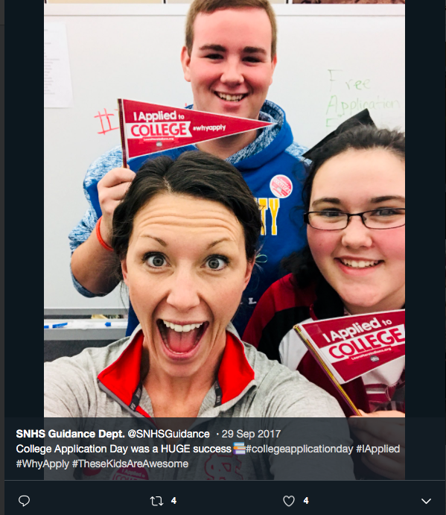

Slide 8
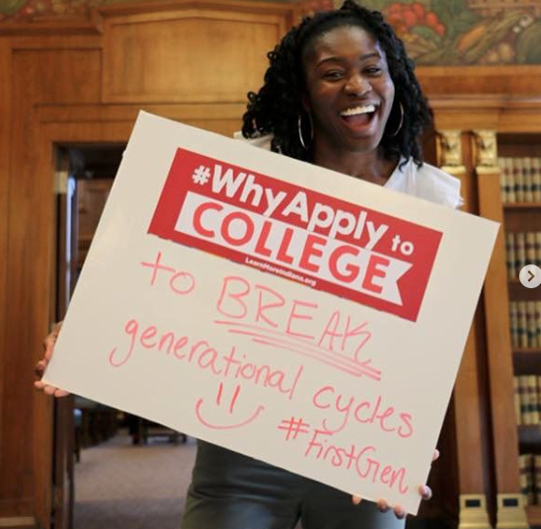

Slide 9
College GO! Resources
Campaign Starter Kit with activity ideas
Links to College Virtual Tours
Student Announcements
Posters and Bulletin Board Kits
Classroom Activity Sheets
Zoom / Video Backgrounds
College Videos
Virtual Events Calendar
Available at LearnMoreIndiana.org/classroom-materials

Slide 10
College GO! Event Sign-Up
Schools planning to participate in College GO! can register to be an official host site
Participate in College GO! week by implementing college and career readiness programs and activities
Host sites will receive regular updates about new virtual events and online resources
Sign up at: https://learnmoreindiana.org/college-go -survey/Official host sites will be asked to send Learn More Indiana data about how many students participated in programming (an estimate is fine)

Slide 11
Hosting an Event
Gather seniors in a computer lab or a space with computers OR create a Zoom or Google Meet room they can all join and have them:
Complete college applications
Log into ScholarTrack to complete activities (if Scholars)
Visit https://collegego-lmi.pagedemo.co for an event handbook and other resources to get you started

Slide 12
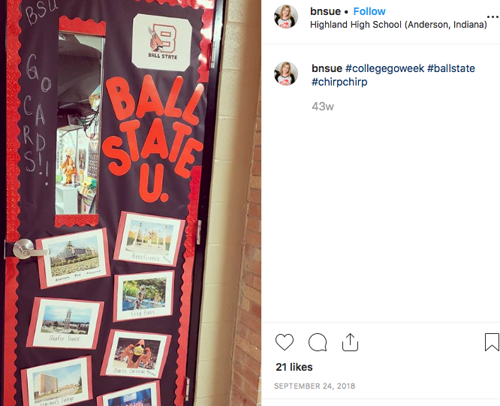
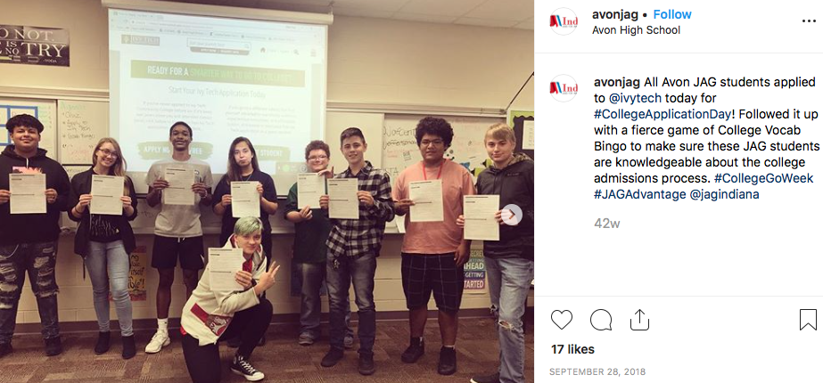
College GO! Event Ideas
Decorate doors / webpages
Play college bingo
Create a spirit week
Take a virtual college tour
Draw pictures of a college mascot
Make a vision board with goals
Take a career interests assessment
Invite an admissions counselor virtually
Write letters to future selves
Research colleges in Indiana
Tag us on social media posts!

Slide 13
How Can We Help?
We want to partner with you in this effort to ensure success
For additional questions: mwalke@che.in.gov

